Slide 1



GenAI @ NNIT
Enterprise grade Large Language Models
1st of June 2023
Info session
Know It Now
KITN, GPT Based Document Sourcing Platform

Slide 2
What to experience today
4
Logo Decision
and Q&A
3
How to use it
2
NNITs Platform and why this Beta?
KITN
1
What is GenAI
WHAT
CONSIDERATIONS
HOW
DISCUSS

Slide 3



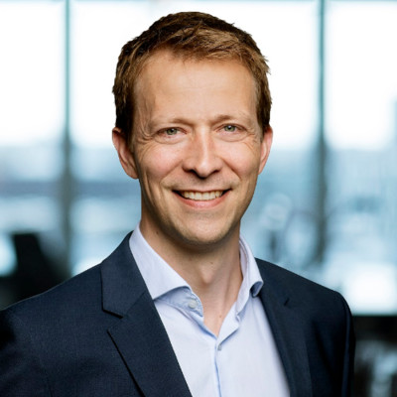

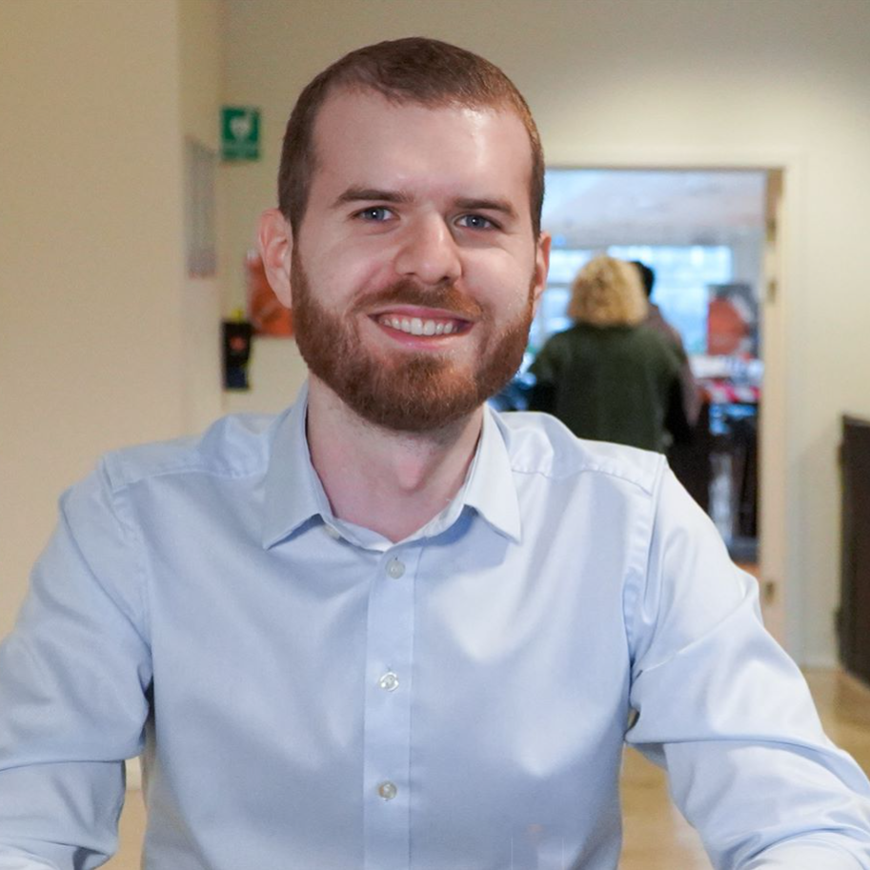
A massive thanks to the team
MAAA
MAPN
NKAE
MADO
SEFG

Slide 4
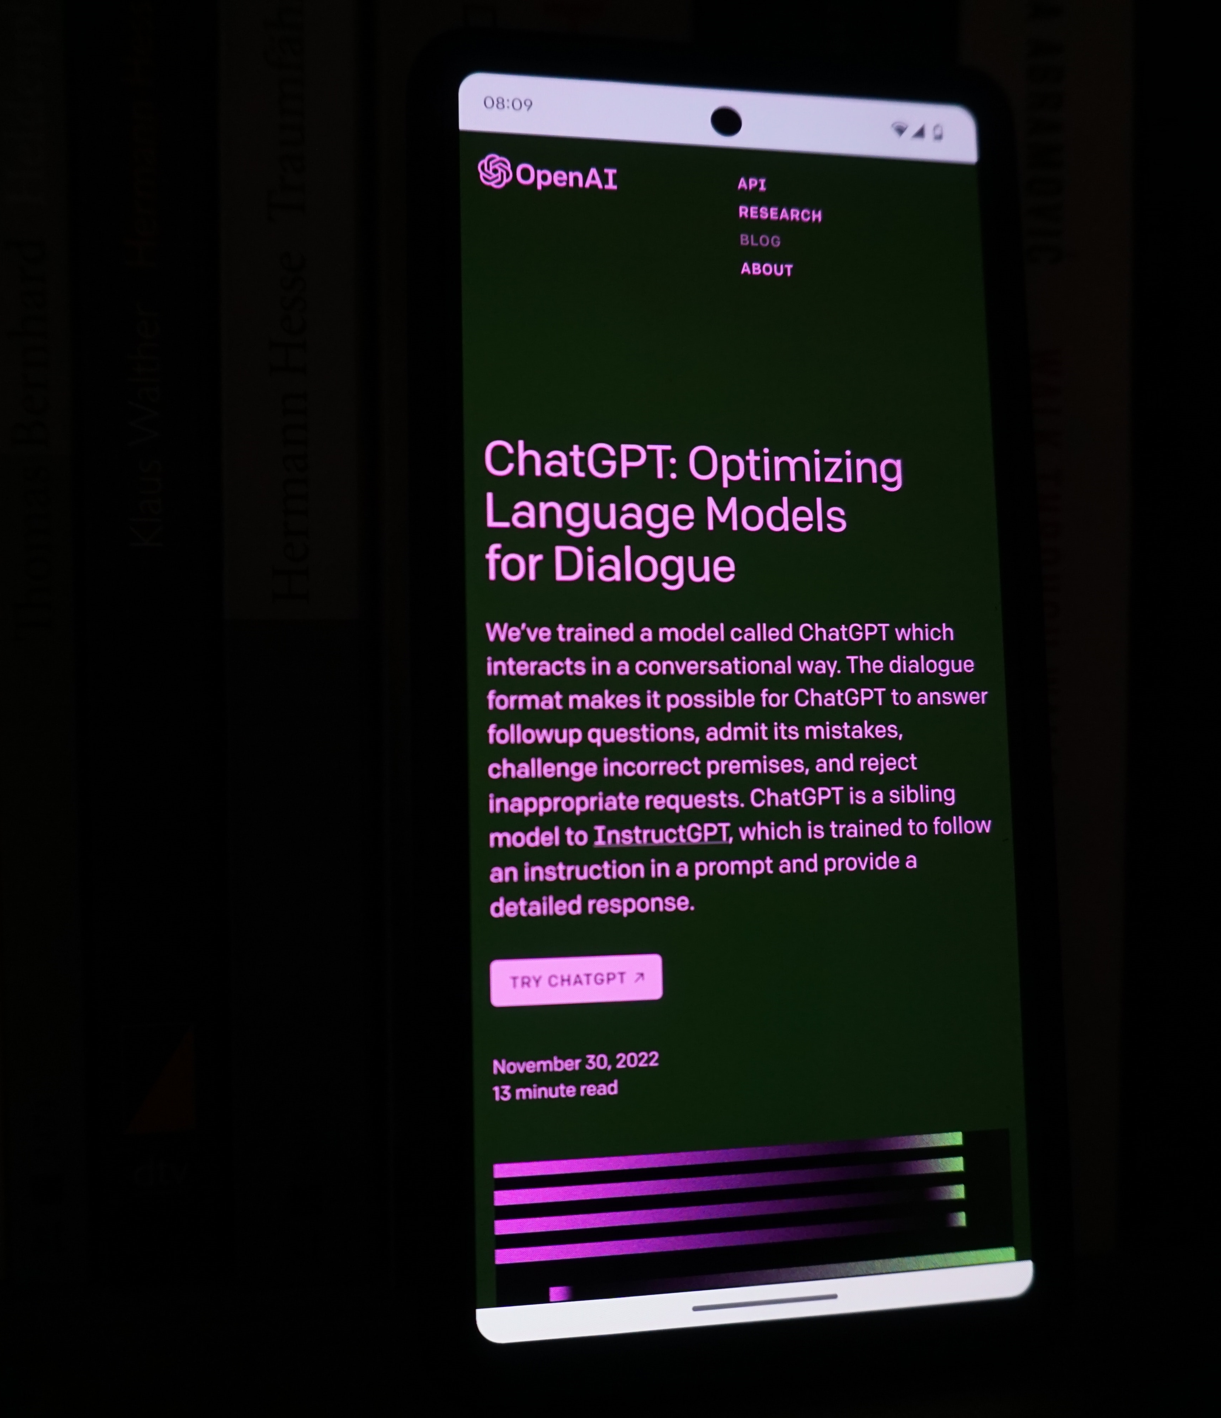
What is GenAI?
What is NNITs opportunity?
What is GenAI?

Slide 5

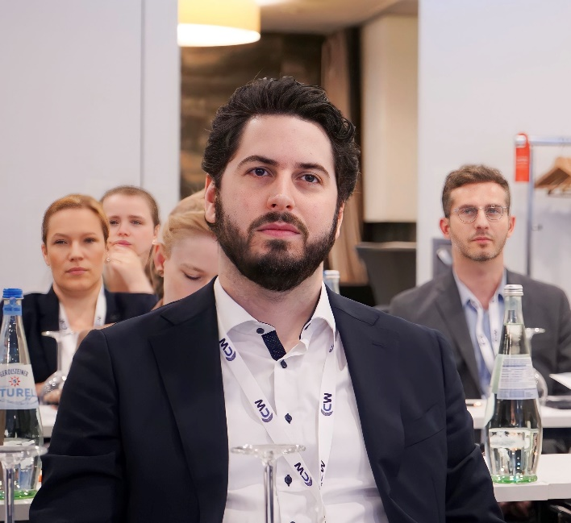

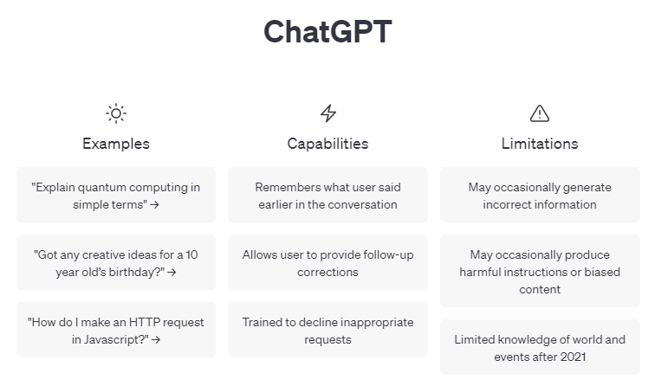
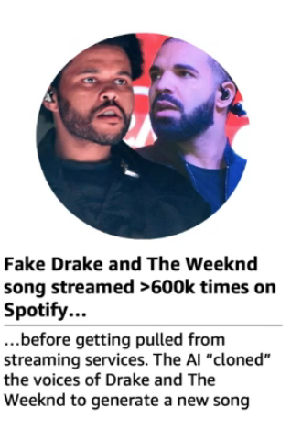
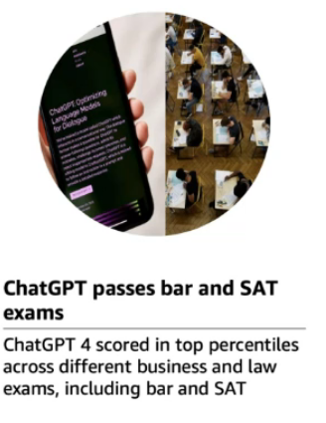

Generative AI: The hype and the use cases
Content Generation
Automatically generate responses to customer inquiries
Generate personalized UI for your website
Summarization
Summary of customer support conversation logs
Summarization (e.g.Financial reporting, analyst articles)
Social media trends summarization
Code Generation
Convert natural language to SQL (or vice versa) for telemetry data
Convert natural language to query proprietary data models
Code documentation
Semantic Search
Search reviews for a specific product/service
Information discovery and knowledge mining

Slide 6

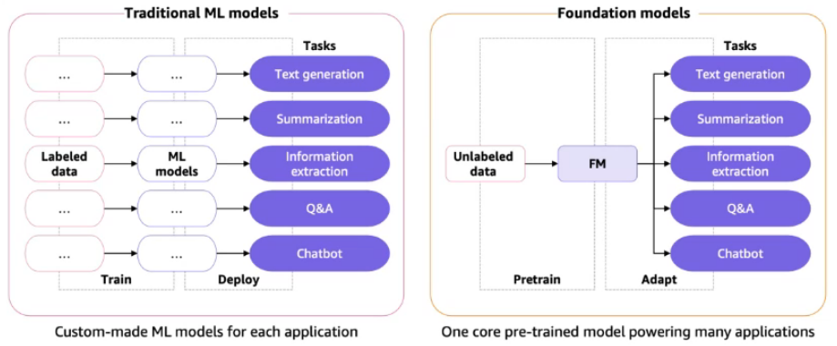

Address business challenges and help our clients with AI transformation
Business challenges
When adopting AI, companies face challenges related to the talent gap, as finding and retaining skilled AI professionals can be difficult. They must navigate regulatory concerns surrounding ethics, privacy, and bias, while also addressing change management and organizational culture shifts, and ensuring effective maintenance and integration of AI systems with existing infrastructure and processes.
Opportunities
Our objective is to assist clients in navigating the intricacies of AI adoption, uncovering strategic opportunities, crafting personalized AI solutions, and delivering continuous support to maximize the value and impact of AI within their organizations. With our specialized focus on IT transformation in the life sciences industry, we could offer a range of services such as AI workshops, readiness checks, advisory sessions, technology assessments, and implementation.

Slide 7
The Beta release of NNITs AI/GPTPlatform - KITN
AI
Rule based learning
computer scientists seek to create intelligent machines that can replicate or exceed human intelligence.
1950
Machine Learning
1960
Regression/classification of structured data (numeric/categorical), forecasting
Classical machine learning algorithms for supervised learning being developed
Our GenAI One-Pager
The KITN Platform
KITN Beta
KITN Architecture and considerations
2012
Deep Learning
NLP, Computer vision, image recognition
Deep learning models to classify images into one of 1,000 object categories
2022
Generative AI
ChatGPT, Chatbots,
Synthetic data and images
ChatGPT and DALL-E 2 are released by OpenAI making generative AI available to the public.

Slide 8


½
.
NNIT
Know it Now GPT-assisted data sourcing
How can generative AI use your organization’s unstructured data to produce insights?
Use conversational AI and integrated LLMs to extract actionable insights from unstructured data effortlessly. Empower decision-makers and gain a competitive edge.
KITN is a solution based on large language models (LLMs) and generative artificial intelligence (AI). KITN harnesses the power of generative AI to make knowledge accessible and actionable, enabling organizations to overcome common challenges in leveraging knowledge, including information overload, silos, unstructured data, discoverability, and search.
With NNIT's expertise in the Life Sciences industry, we are the preferred partner for AI transformation, providing tailored strategies, fostering a culture of innovation, and designing and implementing AI-based solutions.
Contact us today to unlock the full potential of your organization's knowledge and gain a competitive edge in the digital age.
Users
We are experienced in deploying AI-based solutions
Retrieve data from any document and get meaningful responses
Elaborate,
Question
context-
specific answer
Supports multiple languages and documents
Focus on higher-value activities
Dynamic, contextually rich interactions
GPT
-
powered
Organization’s
data:
application
MES specs
Customer service docs
Onboarding docs
SOPs
Legal documentation

Slide 9


KITN as a first in its generation GenAI Platform for NNIT One platform, cloud enabled or on-prem, to support the many usecases
Qdocs Migration
Process Navigator
Recipe Editor
MES Instructor
Aura-X
PVA Reconcil.
TrialTalk
RfP
Qpoint / Training / KM
Usecases
FastTrack
Quality Tailored Prompting
Manuf/ Lab Tailored Prompting
RA/ Safety Tailored Prompting
Clinical Tailored Prompting
Internal Tailored Prompting
Domains
NNIT AI platform
Platfom Agnostic
Know It Know – KITN Platform
Azure
GPT-J-6B
OpenAI
1 Platform
Ability to install this solution completley ”off the internet”. Ideal for business critical documents, GDPR, PII data,…
Utilise the scalability of the cloud within customers their own tenant. Exisitng corporate/regional security policies apply.

Slide 10
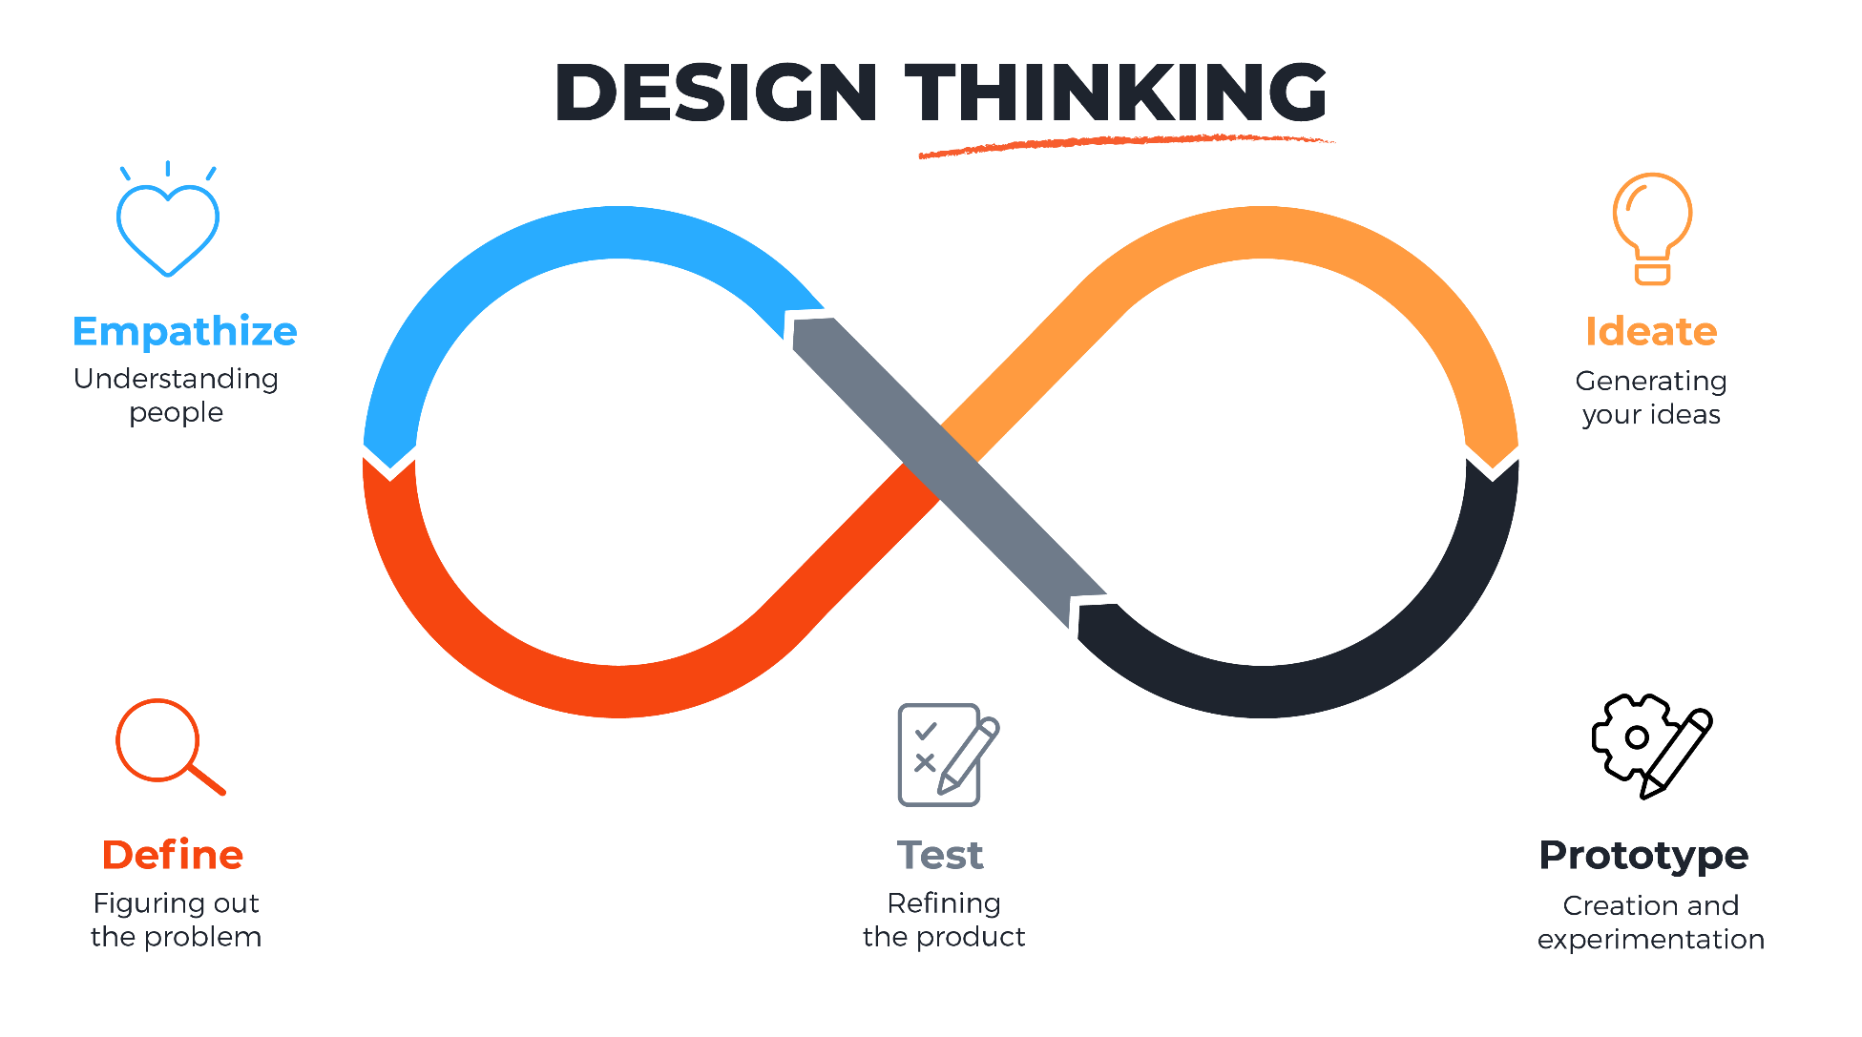
Why this Beta release?
Our beta will run for two to three weeks as we iterate through the design thinking loop.
We need to test the infrastructure.
The system will be slow, crash and give weird results.
We are not the user
Based on your testing, you will get ideas and request features that we could not imagine.
We need to define where it make sense to use GPT tech and where not
We need to prioritize our backlog of features.
Seperate environments per area?
Tailored prompting?
Performance?

Slide 11
Hallucinations
”I tried chatGPT and it made up facts, it sounded real but when I investigated it was completely wrong.”
Mitigation: Tailor the model and instruct it to not make up facts

Slide 12







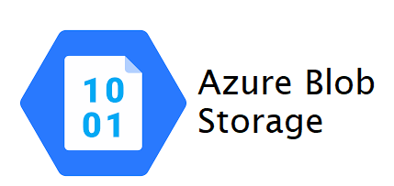

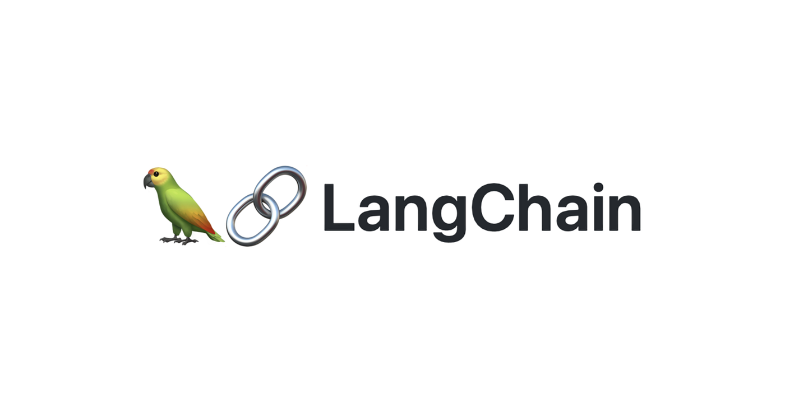
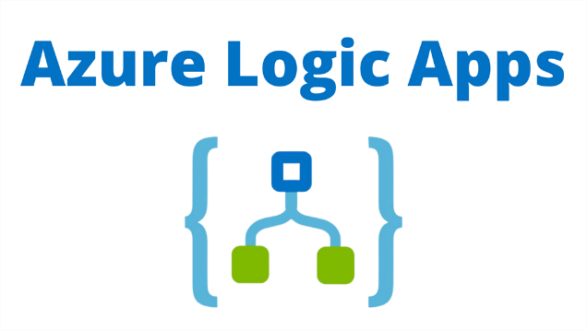



KITN Architecture
VPN Restricted
OR
STORAGE
Every webapp is configured to one collection to restrict access
Sharepoint
Teams
5 Response is given
Web-app backend
LOGIC
Collection Name
1 Question is handed over for processing along with the collection restriction
4 The sources and question are provided to the AI model for summarising
New or removed PDF files trigger an Azure function
Azure Logic Apps
Every Sharepoint folder is linked to 1 Blob container
Removed/New files are removed or added to Azure Blob Storage
3 The transformed question is handed to the vectorstore which identies relevant documents.
The sources are than sent back to LangChain.
ChromaDB
Vectorstore
2 Question is transformed by the model to look for relevant documents in the vectorstore
Azure OpenAI
New or Removed files are added / removed from the index
GPT3.5 Turbo
Notes:
Add cloud indications → Show where the difference sits if you use/do not use cloud

Slide 13

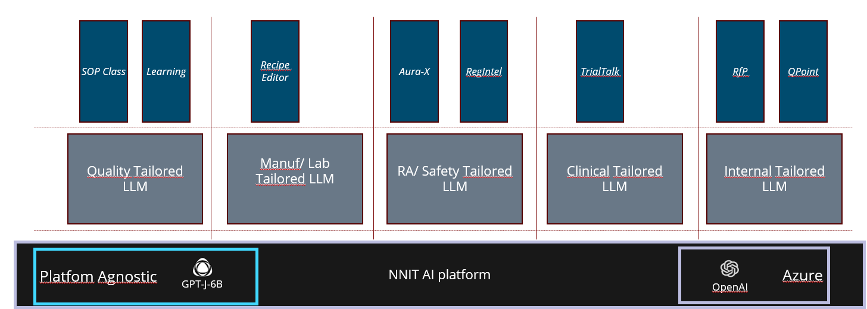


Making it practical
Looking for:
The business uses
Internal processes
Internal sandbox being set-up where you can upload your own documents and use GPT technology to allow you to summarise/extract/inspire you based on our documents.
The first customer to drive priority
Right now our ”running cost” of the demo environment is <€1000/month

Slide 14
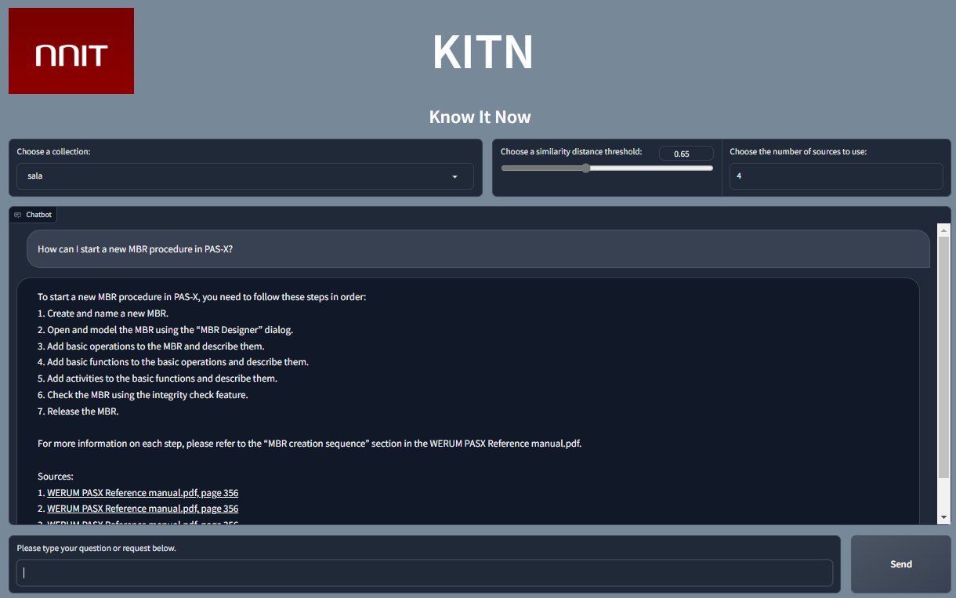
How can I use KITN?
General Introduction
How to start using it?
Known limitations

Slide 15
General Introduction of KITN
How ”fuzzy” you want your search to be. Bigger number is more fuzzy, smaller number is more accurate
The max number of sources the tool will return. Max is 10, default is 4
Collection is the name of the folder on MS Teams in which you have stored your documents
Your previous question
The sources that link directly to the PDF and page where it found the information that it based its answer on. VERIFY THEM!
The summarised answer based on the source information
Chatbox to type your question

Slide 16

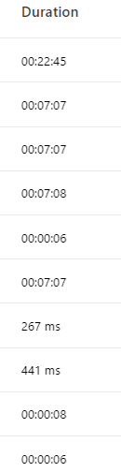
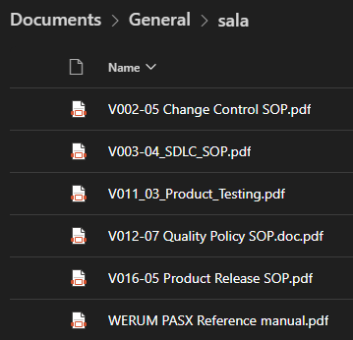
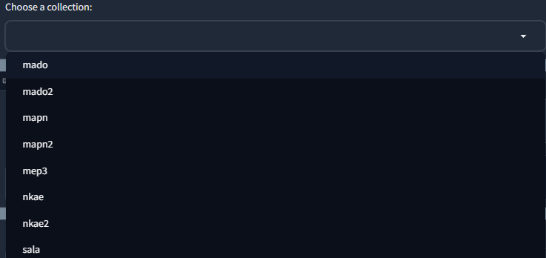
How to start using it?
Wait for 10min
Create a folder in the following MS Teams: Folder name between 3-63 characters Only letters and numbers and - No special characters. No more than 1 – next to each other NO SUBFOLDERS
Once created, upload English PDFs in the folder
Automatically the PDFs will be uploaded to Azure and will be made available for the AI to investigate their content
Go to http://nnit-kitn.northeurope.cloudapp.azure.com/ while connected to the VPN
Select your collection (the same as the MS Teams folder you created) from the list
Ask away!
Verify your sources!
Depends on PDF size and utilisiation

Slide 17
Known Limitations
When creating a folder, it might take a minute or two before it's fully added to the model. refresh the interface every now and then and click the drop-down menu with collections to see if it's been added yet. Please do not add any documents to the folder/collection on SharePoint until you see the collection is added to the dropdown menu.
When adding documents, you can add them either individually or multiple at once, upload no more than 10 PDFs at the same time.
Support format and language is PDFs and English only. Right now we only support PDFs that are OCRd (no scanned documents, you need to be able to select the text in Adobe)
When the model answers a question on the interface, if it finds information to answer your question amongst the documents it has access to, it will use those as sources to answer the question and at the bottom of the bots chat message will be links to the source documents in question. If no documents are found containing info about your question, the model might still try to answer your question, but no references will be provided. The model might also just tell you that it doesn't know the answer.
And just for the sake of precautions, please don't upload documents with personal information, business secrets, and the like.
There is a known bug where the interface “freezes”, we are investigating and need more people testing the solution to identify the issue. If you have not gotten an answer in less than 30 sec you will not get one, most answers take +-5 sec.

Slide 18
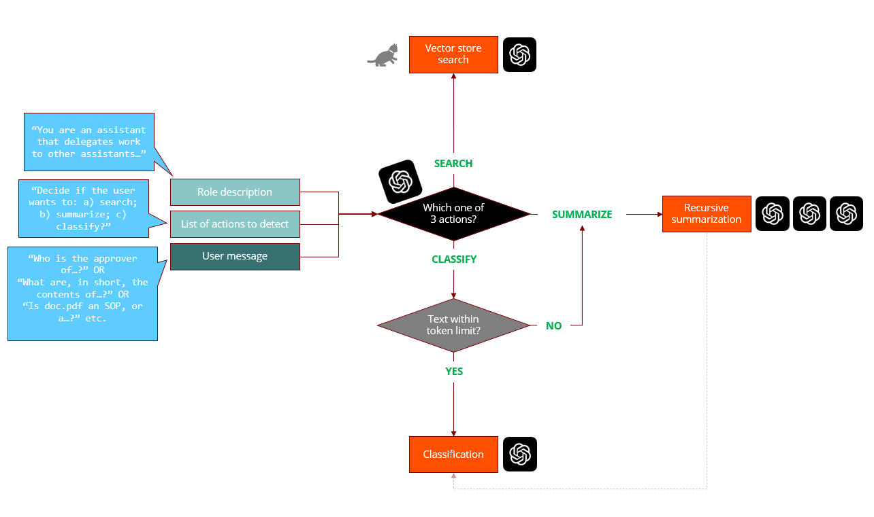
Upcoming features
To be prioritised:
Excel and Powerpoint support
Multi-language
Automatic intent recognition
Subfolder and library support

Slide 19
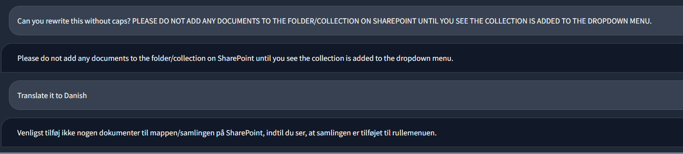
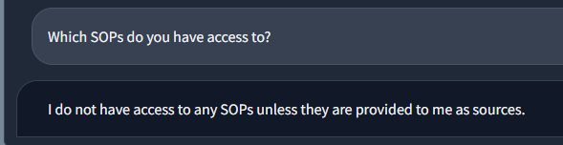
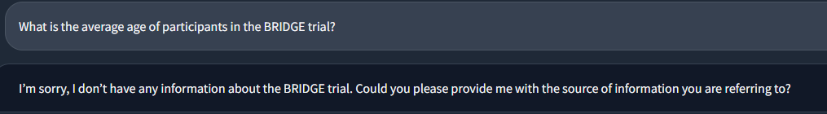
Tips and Tricks
You can use this for ”basic” GPT operations such as ”summarise this text…….”
It does not have information on its ”library”, meaning you can ask questions about the CONTENT, but not about the FOLDER in which they are sitting.
In case the model has no source to answer your question, it will ask you a follow-up question. In rare cases it might hallucinate, you identify the hallucinations if the AI did not provide you a source you can click on

Slide 20




Logo Voting and QnA
Four Logos for the Platform
Questions and hopefull answers

Slide 21
Voting on the KITN Logo
Logo A
Logo B
Logo C
Logo D

Slide 22

Q&A

Slide 23

Cost drivers
Major cost drivers
Pricing for this solution is somewhat uncertain, but the major drivers are:
Infrastructure: hosting of databases, app, scripts.
Data storage
AI Services: often billed per 1000 tokens used.
Development
Support and maintenance
Other considerations
There are several free open-source language models, embedding models, and vector databases. This can have a significant impact on cost. Nevertheless, there may be some concerns with regards to commercial licensing and risks (e.g. security, support, maintenance, compliance).
Pricing examples
OPENAI embedding model Ada v2: $0.0004 / 1K tokens
OPENAI embedding model Davinci v1: $0.2000 / 1K tokens
OPENAI Chat model GPT-3.5-Turbo: $0.002 / 1K tokens
Pinecone Enterprise plan: starting at 104 $/month

